Slide 1
Contrastive Learning in PA Relevance
- Kavya, Keng-Hao

Slide 2
How it all STARTED
Revamp the existing web4ads DL model in L2 Ranker from CDSSM to Twinbert -> a better architecture
Augmenting web4ads information to query helps in understanding the query better -> a better query representation
Contrastive learning as objective function -> gained popularity in recent times especially as a pretraining objective for recall-based tasks

Slide 3
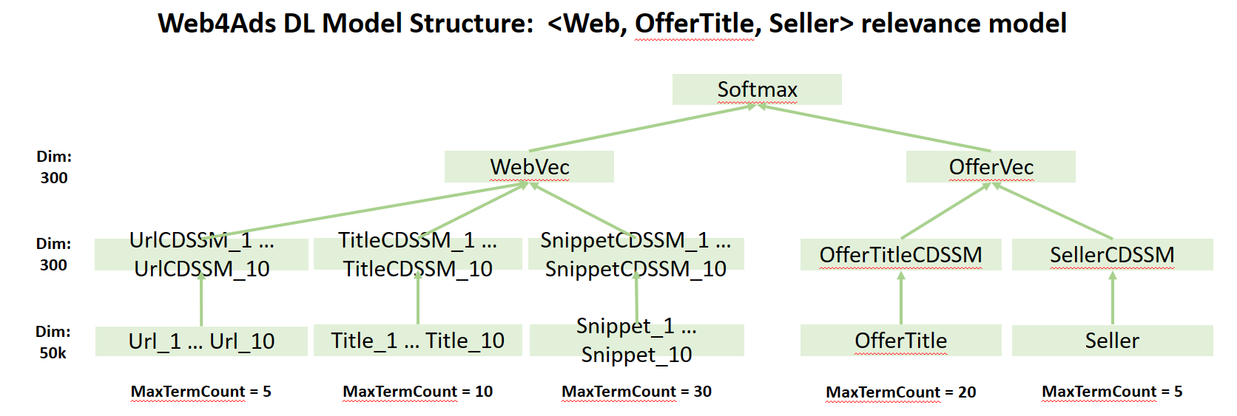
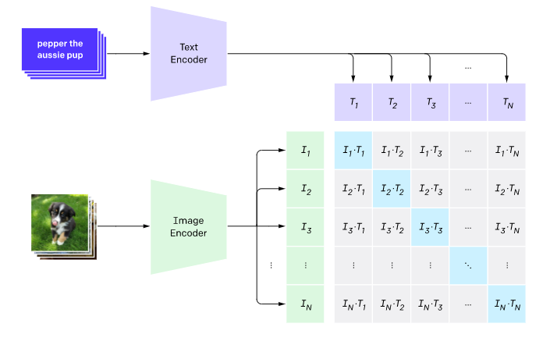
Current vs revamp
CLIP Loss
CLIP: Connecting Text and Images (openai.com)
Labels = identity matrix
Symmetric loss
Query Bert Encoder Query+" "+WebSerpTitle1+ " "+WebSerpUrl1 (32 tokens)
* Word piece tokenization
Offer Bert Encoder AdTitle+" "+AdSeller+" "+AdBrand+" "+AdDomain+" "+AdDescription (64 tokens)
* Word piece tokenization

Slide 4
Some details on twinbert and contrastive learning
Contrastive Objective
Contrastive Learning
Contrastive learning is a popular form of self-supervised learning that encourages augmentations (views) of the same input to have more similar representations compared to augmentations of different inputs
In our case we try to keep embeddings of queries closer to their corresponding clicked offers compared to other offers in the corpus
Twinbert
4-layer bert
Separate query, offer encoder
Downscale = 128
Cosine similarity
Ads vocab
WordPiece tokenization
Cosine Similarity
Downscale (128)
Downscale (128)
Weight Pooler
Weight Pooler
Query Encoder
4-layer Bert
12 self attention heads
Hidden dimension 768
32 tokens
Offer Encoder
4-layer Bert
12 self attention heads
Hidden dimension 768
64 tokens

Slide 5

Experimentation

Slide 6
Exp1: use pa clicks from control flight
Test Dataset | Variant | ROC_AUC
FBS dataset from 2021-11-01 till 2022-04-30 | CLIP Loss with bs-1 negatives | 0.6733
Adcopy Judgement = good|fair|excellent then 1 else 0 | CLIP Loss with 10 random neg | 0.6749
 | CLIP Loss with 50 random neg | 0.6790
 | InfoNCE Loss with 10 random neg | 0.6726
 | InfoNCE Loss with 50 random neg | 0.6762
 | maxmargin_ngame Loss with 10 topk neg, margin 0.3 | 0.5873
Initially started with US control(10238) PA click dataset for training
Dataset
1 year PA clicked <query,offer> pairs = ~15M
Baseline is trained on 187M datapoints
Input
query : Query+" "+QuerySerpTitle0+" "+QuerySerpUrl0(32 tokens)
offer : AdTitle+" "+AdSeller+" "+AdBrand+" "+AdDomain+" "+AdDescription(64 tokens)
Model
Twinbert
Loss
CLIP
InfoNCE
MaxMargin
In batch negatives
CLIP with full batch size like in original paper
CLIP with random-k (k=10, 50, 100). 100 wasn’t better than 10|50
InfoNCE with random-k (k=10, 50, 100). 100 wasn’t better than 10|50
Tried non-random strategies as well like topk – didn’t work
Model Params
Batch size = 1024
Gpus = 4
Note
After observing the metrics, for further experimentation
we resort to CLIP random 50
Single Feature ROC_AUC
Test Set | Baseline | InfoNCE 50 | Clip 10 | Clip 50
FBS_10238_2021-11-01_2022-04-30 | 0.6338 | 0.6762 | 0.6749 | 0.6790
fbs2020h1 | 0.6313 | 0.6867 | 0.6895 | 0.6898
fbsBeforeL2 | 0.7949 | 0.8336 | 0.8351 | 0.8264
L1fbs2021 | 0.5852 | 0.6012 | 0.6026 | 0.6016
newGLDataset | 0.6304 | 0.6902 | 0.6931 | 0.6941
fbsOnImpression | 0.6440 | 0.6959 | 0.6972 | 0.6994
2017h1 | 0.6746 | 0.7085 | 0.7145 | 0.7089

Slide 7
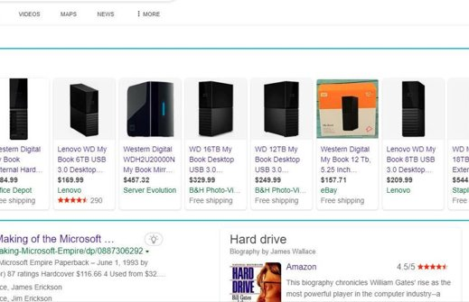
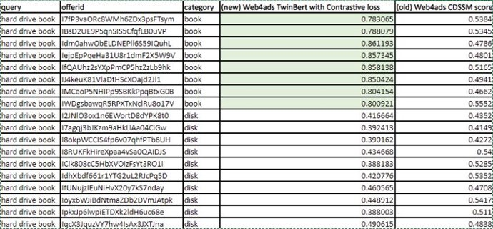
Example dsat where revamped model works better
“Hard drive book”

Slide 8
Exp2: Use pa clicks from all flights
Single Feature ROC_AUC |  | Exp 1 | Exp 2
Test Set | Baseline | Clip 50 | Clip 50
FBS_10238_2021-11-01_2022-04-30 | 0.6338 | 0.6790 | 0.6545
fbs2020h1 | 0.6313 | 0.6898 | 0.6550
fbsBeforeL2 | 0.7949 | 0.8264 | 0.7523
L1fbs2021 | 0.5852 | 0.6016 | 0.5867
newGLDataset | 0.6304 | 0.6941 | 0.6609
fbsOnImpression | 0.6440 | 0.6994 | 0.6603
2017h1 | 0.6746 | 0.7089 | 0.6808
Dataset
1 year (2021-07 till 2022-05) PA clicked distinct <query, offer> pairs = ~90M
ctr>1% & clicks>=2
Input
query : Query+" "+QuerySerpTitle0+" "+QuerySerpUrl0(32 tokens)
offer : AdTitle+" "+AdSeller+" "+AdBrand+" "+AdDomain+" "+AdDescription(64 tokens)
Model
Twinbert
In batch negatives
Random 50
Model Params
Batch size = 1024
Gpus = 4
Notes
After observing a drop in metric, we started investing time in hyperparameters like batch size, #negatives and their effect on contrastive learning. Most of the SOTA research papers do suggest larger batch sizes like 16k. Their reason behind using bigger batch size is for larger negative samples since the #negatives used in standard contrastive learning setting = bs-1

Slide 9
Exp3: Ablation study on batch size, #negatives, sampling strategy
ROC_AUC | Training Dataset : 1 yr all flights click data, ctr>1% & clicks>=2 (2021-07 till 2022-05)
 | query : Query+" "+QuerySerpTitle0+" "+QuerySerpUrl0(32)
 | offer : AdTitle+" "+AdSeller+" "+AdBrand+" "+AdDomain+" "+AdDescription(64)
 | projection_dim=128 epochs=5
Test DataSet | Baseline | bs=256 |  |  | bs=512 |  |  | bs=1024 |  |  | bs=2048 --> 512*4 |  |  | bs=4096 --> 1024*4 |  |  | bs=8192 --> 1024*8
 |  | random(50) | non-random (topk-50) | batchsize-1 | random(50) | non-random (topk-50) | batchsize-1 | random(50) | non-random (topk-50) | batchsize-1 | random(50) | non-random (topk-50) | batchsize-1 | random(50) | non-random (topk-50) | batchsize-1 | random(50) | non-random (topk-50) | batchsize-1
FBS_10238_2021-11-01_2022-04-30 | 0.6338 | 0.6579 | 0.6664 | 0.6609 | 0.6547 | 0.6736 | 0.6585 | 0.6568 | 0.6709 | 0.6563 | 0.6544 | 0.6543 | 0.6482 | 0.6556 | 0.6627 | 0.6502 | 0.6663 | 0.6684 | 0.6531
fbs2020h1 | 0.6313 | 0.6637 | 0.6644 | 0.6579 | 0.6505 | 0.6734 | 0.6564 | 0.6595 | 0.6684 | 0.6524 | 0.6525 | 0.6506 | 0.6385 | 0.6516 | 0.6621 | 0.6417 | 0.6892 | 0.6735 | 0.6446
fbsBeforeL2 | 0.7949 | 0.7570 | 0.7519 | 0.7373 | 0.7369 | 0.7318 | 0.7387 | 0.7516 | 0.7144 | 0.7248 | 0.7400 | 0.7281 | 0.7051 | 0.7335 | 0.7474 | 0.7067 | 0.8343 | 0.7609 | 0.7095
L1fbs2021 | 0.5852 | 0.5840 | 0.5843 | 0.5845 | 0.5827 | 0.5805 | 0.5832 | 0.5850 | 0.5780 | 0.5815 | 0.5847 | 0.5801 | 0.5780 | 0.5837 | 0.5850 | 0.5772 | 0.5988 | 0.5876 | 0.5776
newGLDataset | 0.6304 | 0.6687 | 0.6686 | 0.6620 | 0.6559 | 0.6779 | 0.6627 | 0.6655 | 0.6738 | 0.6588 | 0.6593 | 0.6573 | 0.6447 | 0.6591 | 0.6693 | 0.6480 | 0.6976 | 0.6807 | 0.6519
fbsOnImpression | 0.6440 | 0.6696 | 0.6745 | 0.6664 | 0.6551 | 0.6774 | 0.6597 | 0.6642 | 0.6779 | 0.6613 | 0.6585 | 0.6550 | 0.6518 | 0.6550 | 0.6655 | 0.6555 | 0.7057 | 0.6752 | 0.6576
2017h1 | 0.6746 | 0.6947 | 0.6883 | 0.6826 | 0.6640 | 0.6815 | 0.6715 | 0.6811 | 0.6882 | 0.6774 | 0.6702 | 0.6764 | 0.6749 | 0.6673 | 0.6803 | 0.6731 | 0.7119 | 0.6857 | 0.6803
Notes
The maximum batch size I tried was 8192. I only maxed out a single node (8 gpus) on V100 machine. Borrowed the “all gather” idea from @Sheshansh for this.
Based on the above metrics, clearly a larger batch size is beneficial but not from the #negatives perspective. This called in for further analysis on what’s exactly benefitting the random sampling over bs-1 (standard). Initial hunch was that the noise in clicks might be playing a bigger role here but wanted to study this empirically.

Slide 10
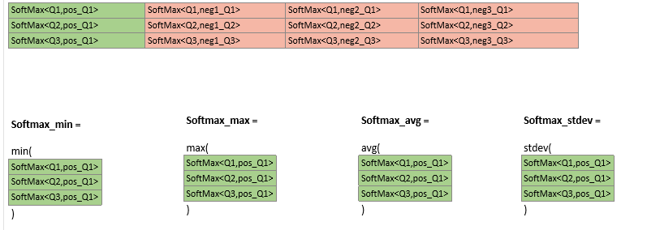
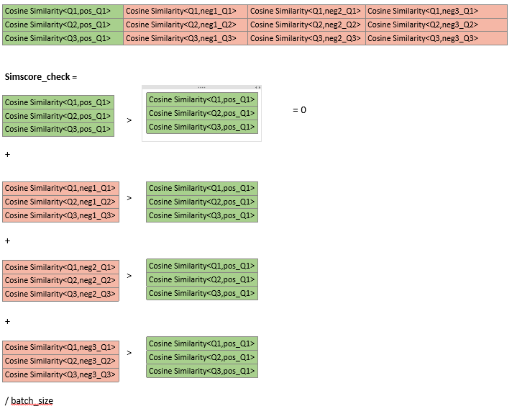
Analysis: Is noise playing a part?
5 simple metrics to study training dynamics
SoftMax_min
SoftMax_max
SoftMax_avg
SoftMax_stdev
Expectation is → as training goes by SoftMax_min/max/avg moves closer to 1 where as the SoftMax_stdev moves closer to 0
SimScore_check
Expectation is → that as training goes by SimScore_check moves closer to 0
Notes
These metrics show that as batch size increases and keeping #negatives = bs-1 the learning seems to get harder
Even with a smaller number of updates 256 bs-1 10000 step is lower than the same step for 8192 random-50

Slide 11
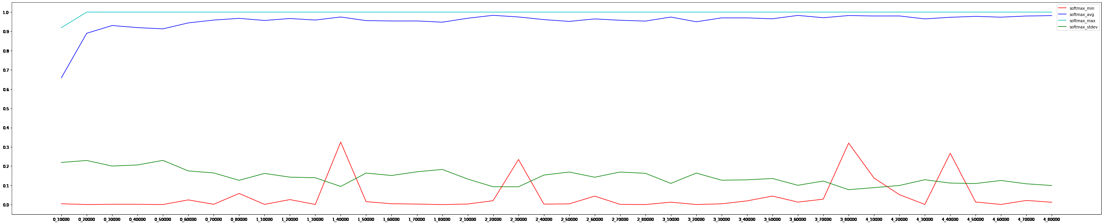
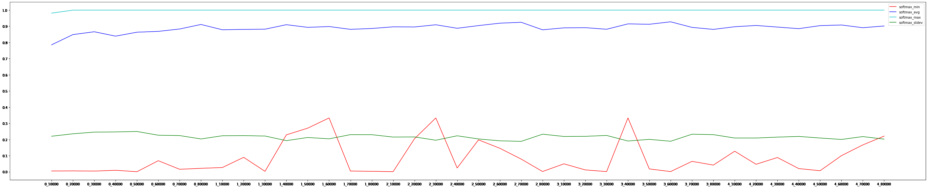
Bs-1
Random-50
BS = 256
Training dynamics (Web view)

Slide 12
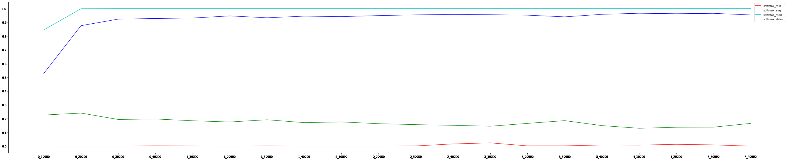
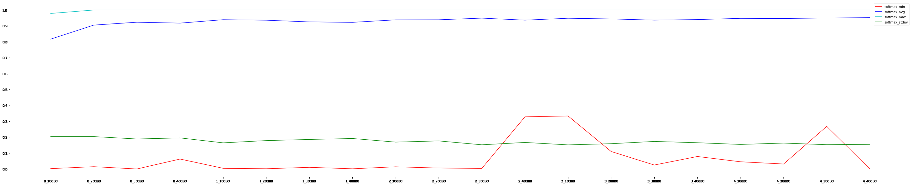
Bs-1
Random-50
BS = 512

Slide 13
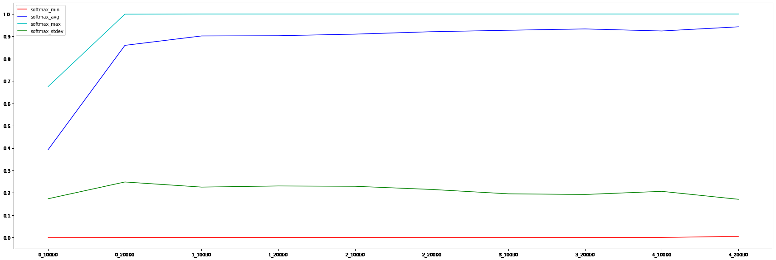
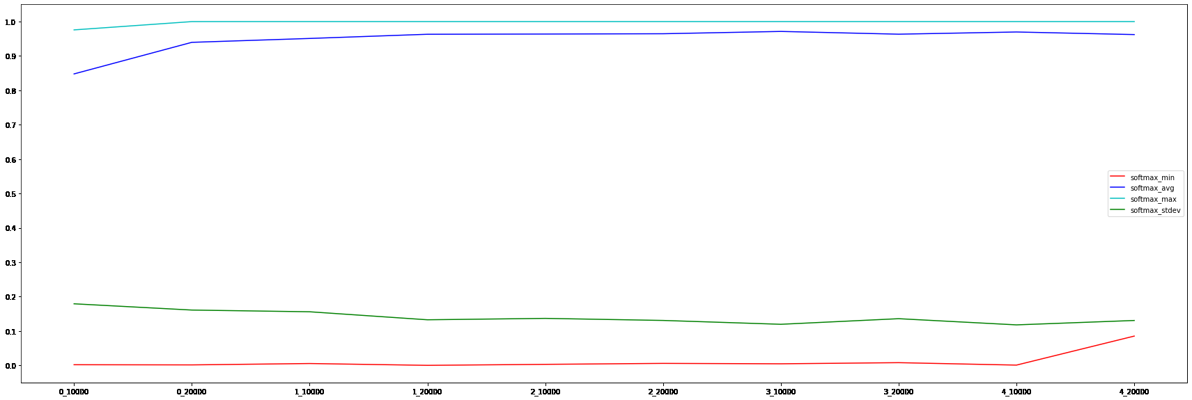
Bs-1
Random-50
BS = 1024

Slide 14
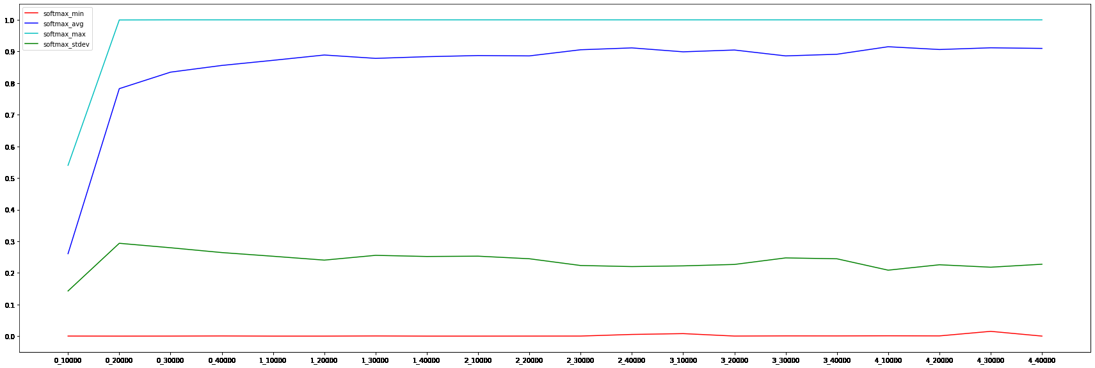
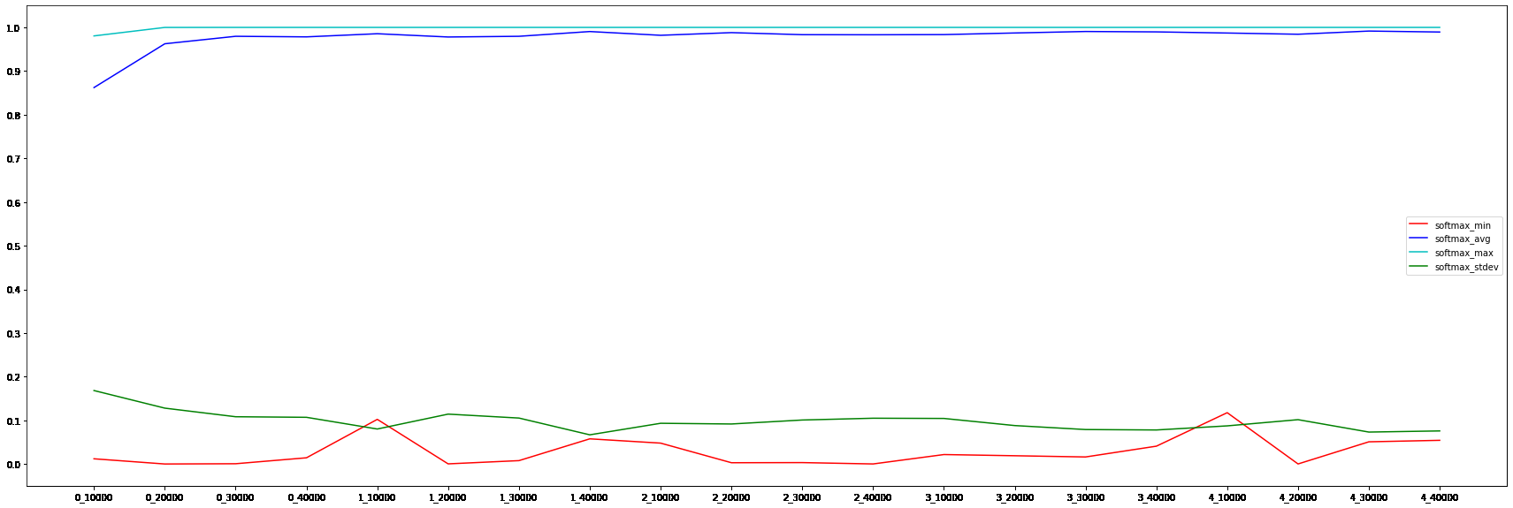
Bs-1
Random-50
BS = 2048

Slide 15
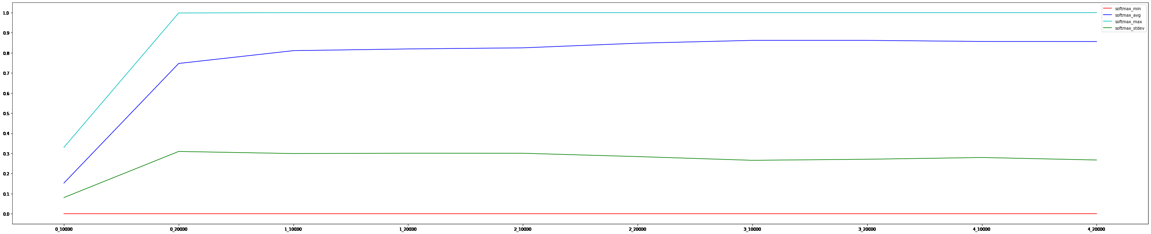
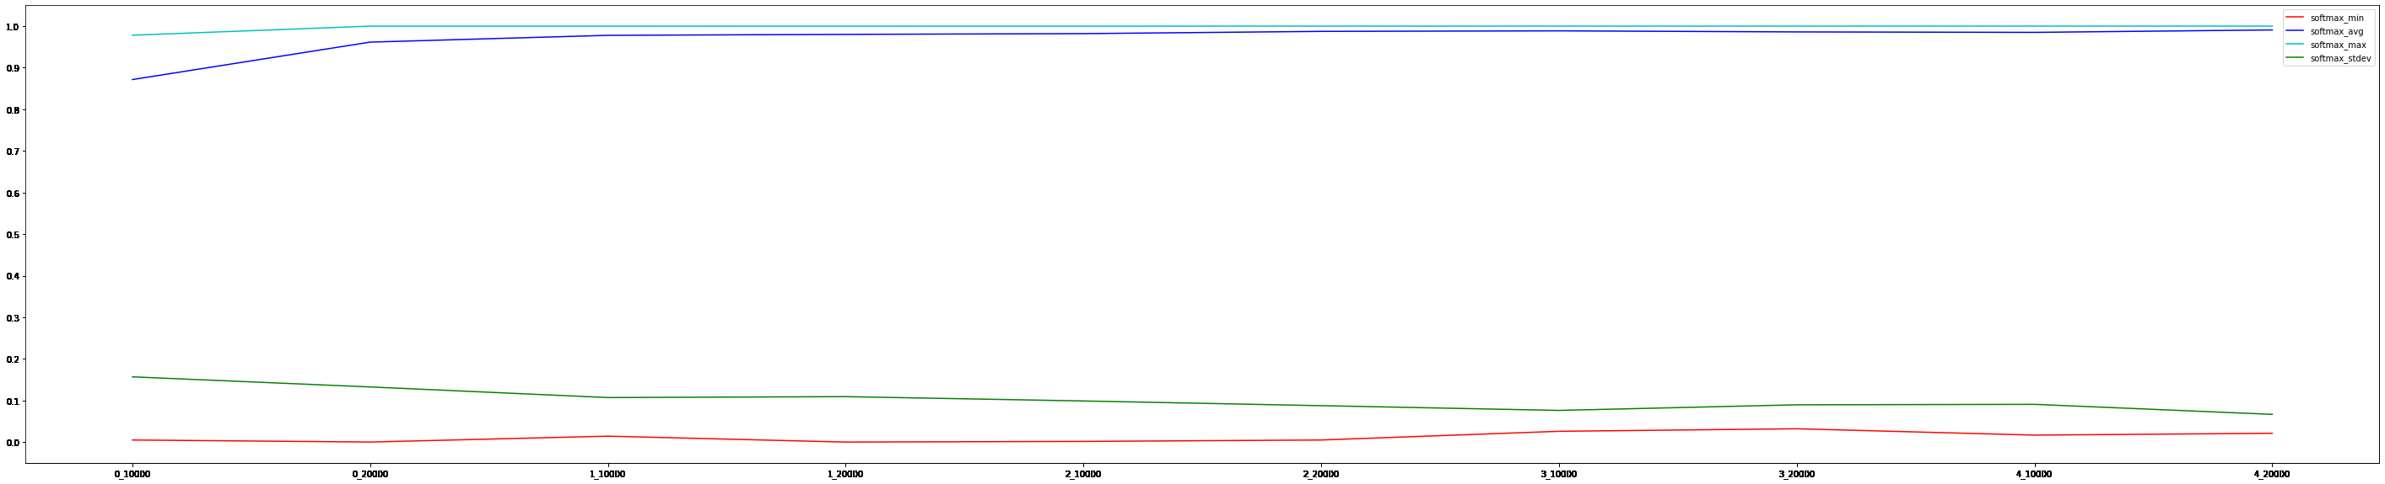
Bs-1
Random-50
BS = 4096

Slide 16
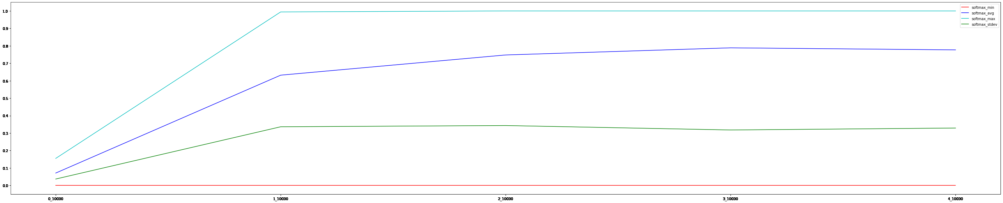
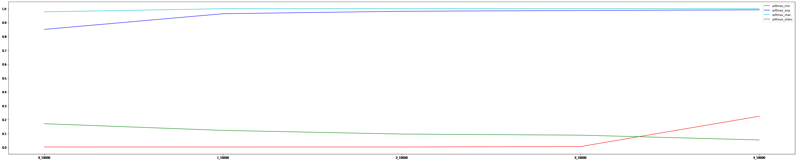
Bs-1
Random-50
BS = 8192

Slide 17
While studying about large batch size dependency in contrastive learning I stumbled up on an interesting paper (linked below) from DeepMind which does an empirical study negating this standard batch size, #negatives relationship. They use a training dynamic called gradient SnR (Signal to Noise ratio) to explain this. If interested, please go ahead and have a look.
pdf (openreview.net)

Slide 18
Exp4: exploring good quality click datasets
ROC_AUC | Baseline | Exp3 | Exp4
 |  | bs=8192 | bs=8192
 |  | Random (50) | Random (50)
FBS_10238_2021-11-01_2022-04-30 | 0.6338 | 0.6663 | 0.6803
fbs2020h1 | 0.6313 | 0.6892 | 0.6916
fbsBeforeL2 | 0.7949 | 0.8343 | 0.8218
L1fbs2021 | 0.5852 | 0.5988 | 0.5988
newGLDataset | 0.6304 | 0.6976 | 0.6984
fbsOnImpression | 0.6440 | 0.7057 | 0.7021
2017h1 | 0.6746 | 0.7119 | 0.7020
Got introduced to PA Good Click datasets. Talked to @swaraj and gathered a good click dataset they use for CP model training
https://www.cosmos08.osdinfra.net/cosmos/Bingads.algo.prod.IntentMatching/shares/bingads.data.clickpredict/data/ClickPrediction/PA/Woodblocks/WBData_v2_DTv2
Used goodclicksv2 as a substitute to click and below is the definition
DwellTimeCatV2
=-1 & 2 --> goodclick
=1 --> quickback
=-2 --> ignore
Dataset
1 yr PA good click v2 (2021-07 till 2022-05) = ~200M
Input
query : Query+" "+QuerySerpTitle0+" "+QuerySerpUrl0(32 tokens)
offer : AdTitle+" "+AdSeller+" "+AdBrand+" "+AdDomain+" "+AdDescription(64 tokens)
Model
Twinbert
Notes
Got a slight improvement over the above best in some test sets (especially new GL). Might require slightly more parameter tuning but this direction looks promising. There is a difference in PA jenny log and PA good click dataset in terms of the <query,offer> pairs though. As a future work will need to figure this difference out and see if a further improvement is plausible.

Slide 19
Exp5: Better initialization
Single Feature ROC_AUC |  | Exp3 | Exp5
 |  | bs=8192 | bs=8192
Test Set | Baseline | Random (50) | Random (50)
FBS_10238_2021-11-01_2022-04-30 | 0.6338 | 0.6663 | 0.6704
fbs2020h1 | 0.6313 | 0.6892 | 0.6978
fbsBeforeL2 | 0.7949 | 0.8343 | 0.8465
L1fbs2021 | 0.5852 | 0.5988 | 0.6017
newGLDataset | 0.6304 | 0.6976 | 0.7094
fbsOnImpression | 0.644 | 0.7057 | 0.7163
2017h1 | 0.6746 | 0.7119 | 0.7406
Out of curiosity, I tried initializing my model with TA Web4Ads checkpoint. This did improve the metric but is limited by the input format so didn’t pursue this any further
Also tried SimCSE as a pre-training objective. This didn’t work.Can try this route in future

Slide 20
DATASET LIMITATION
Ranking defect
Goal
Better query, offer representation learning addressing all/some of the red boxes
Signals/Data
Web4ads
Ideas
Augment query with Bing SERP and train on PA <query, offer> click dataset
The dataset is only limited to PA impressed queries
Doesn’t bring in any new opportunity
Better encoders & learning paradigms can learn better representations
Doesn’t directly target any of the red boxes
We still learn offer associations when query is non-retail if there is a noisy click. We can remove these pairs using ctr, click based thresholding though
defect
Result defect
PA triggered
Retail
perfect
PA not triggered
(under triggering)
Query
Edge3p?
PA not triggered
Any other datasets that can help bring in new signals?
Non-Retail
PA triggered
(over triggering)

Slide 21
Exp6: leveraging edge3p datasets
Intro:
Edge3P is a project which logs the result page and user interactions for select third party sites on Edge. ​
The data is collected without user Personally Identifiable Information (PII).​
Current scope is only limited to Google web vertical.​
Edge3P wiki: https://tpwiki.azurewebsites.net/introduction
We have search queries, ProductAds with clicks and all the WebAlgoResults as part of this log
I collected Edge3p dataset from Jan 2022-aug 2022 for my training purposes. The data is available at cosmos08 Bingads.algo.prod.IntentMatching cosmos/Bingads.algo.prod.IntentMatching/local/Users/pthummuru/Edge3pData/en-us/restricted/ (osdinfra.net). I did some count analysis on this dataset. If interested, please check out TwinBertWeb4AdsV0_Analysis.xlsx (dataset_analysis sheet)
Total clicked PA results in this dataset is ~500K. Since this number is small and PA features are very sparse(only title & url are ~100% covered), as initial efforts we only utilized WebAlgoResults for our training

Slide 22
Goal
Better query, offer representation learning addressing all/some of the red boxes
Signals/Data
Web4ads
Edge3p
PA (many missing features)
Web (clean and neat with all the required features present)
Ideas
Augment query with Bing SERP and train on PA <query, offer> click dataset
The dataset is only limited to PA impressed queries
Doesn’t bring in any new opportunity
Better encoders & learning paradigms can learn better representations
Doesn’t directly target any of the red boxes
We still learn offer associations when query is non-retail if there is a noisy click. We can remove these pairs using ctr, click based thresholding though
PA click dataset augmented with Edge3p (3 encoders)
Brings in PA non-impressed queries whose representations are learned by anchoring to GSerp
Can indirectly poke under/over triggering segment.
Under triggering → pulls a non-impressed query closer to offer demand if Gserp is retailish
Over triggering → pushes an impressed query away from the offer demand if GSerp is non-retailish and entirely different from what offers entail
Might reduce defect
Ranking defect
defect
Result defect
PA triggered
Retail
perfect
PA not triggered
(under triggering)
Query
PA not triggered
Non-Retail
PA triggered
(over triggering)
Similarity
Similarity
Query encoder
Offer encoder
GSerp encoder

Slide 23
Query | Offer | GSerp | Comments
Query+” “+BingSerpTitle1+” “+BingSerpUrl1 | AdTitle+” “+AdSeller+” “+AdBrand+” “+AdDomain+” “+AdDescription | GTitle1+” “+GUrl1+” “+GSnippet1 | Limited to only Bing queries
Bing : Query+” “+BingSerpTitle1+” “+BingSerpUrl1 Edge3p : Query+” “+GSerpTitle1+” “+GSerpUrl1 | AdTitle+” “+AdSeller+” “+AdBrand+” “+AdDomain+” “+AdDescription | GTitle1+” “+GUrl1+” “+GSnippet1 | No limitation. Can bring in new opportunity (queries not even seen by Bing). Still shares the query encoder
Bing : Query+” “+BingSerpTitle1+” “+BingSerpUrl1 Edge3p : Query+” “+GSerpTitle1+” “+GSerpUrl1 | AdTitle+” “+AdSeller+” “+AdBrand+” “+AdDomain+” “+AdDescription | GTitle1+” “+GDomain+” “+GSnippet1 | No limitation. Can bring in new opportunity (queries not even seen by Bing). Still shares the query encoder
ROC_AUC | Baseline | Exp3 | Exp6-1 | Exp6-2
 |  | bs=8192 | bs=8192 | bs=8192
 |  | Random(50) | Random(50) | random(50)
FBS_10238_2021-11-01_2022-04-30 | 0.6338 | 0.6663 | 0.6733 | 0.6755
fbs2020h1 | 0.6313 | 0.6892 | 0.6902 | 0.6902
fbsBeforeL2 | 0.7949 | 0.8343 | 0.8414 | 0.8324
L1fbs2021 | 0.5852 | 0.5988 | 0.6047 | 0.6042
newGLDataset | 0.6304 | 0.6976 | 0.6971 | 0.6986
fbsOnImpression | 0.6440 | 0.7057 | 0.7046 | 0.7029
2017h1 | 0.6746 | 0.7119 | 0.7208 | 0.7144
Dataset
1 year all flights click data, ctr>1% & clicks>=2(100M --> 800M) + Edge3p(800M) (Jan 2022-aug 2022)
Model
Three BERT encoders (4 layer) with CLIP Random 50 loss
Training
Round Robin over batches from two datasets to avoid dataset bias (2112.09331.pdf (arxiv.org))
Notes
Edge3p improves metrics by 1 point. This is a positive sign. After this experimentation we further invested time in creating more training methodologies using Edge3p

Slide 24
perfect
Green – relevance
Purple – retail classification
clicked
noise
PA triggered
(Not adequate features)
Impressed
Never got clicked
Bing offers
G Queries
No Queries
Never Impressed
No PA
Defect
PA click dataset (dwell time thresholding) + Edge3p (retail/nonretail queries based on google PA triggering)​
This naturally brings in newer(outside Bing) queries and target under/over triggering red boxes​
Can target under triggering if those non impressed Bing queries are PA in G​
Can target over triggering if those impressed Bing queries are non-PA in G
Preparedness for tail/new queries in Bing ​
But this setup heavily relies on the quality of G results. We consider G results as ground truth here​
PA triggered
Bing Queries
Perfect
No PA

Slide 25
Exp7: Leverage contrastive ckpt in other tasks
Initializing Twinbert V5(@zhaoju) student training with my checkpoint
Notes
The improvement initialization brings in can be dominantly seen in first epoch but with increasing epochs the difference goes down.
Dataset size used for student training is ~2B. This size seems to be very huge for initialization to play any part.
 | epoch 0 |  | epoch 1 |  | epoch 2 |  | epoch 3
 | TBv5 | PR AUC | TBv5 | PR AUC | TBv5 | PR AUC | TBv5 | PR AUC
FBS_10238_2021-11-01_2022-04-30
fbs2020h1 | 0.9362 | 0.9363 | 0.9384 | 0.9372 | 0.9394 | 0.9387 | 0.9402 | 0.9388
fbsBeforeL2 | 0.5277 | 0.5497 | 0.5327 | 0.5580 | 0.5328 | 0.5522 | 0.5392 | 0.5542
newGLDataset | 0.9264 | 0.9272 | 0.9282 | 0.9285 | 0.9299 | 0.9297 | 0.9303 | 0.9302
fbsOnImpression | 0.8504 | 0.8501 | 0.8523 | 0.8517 | 0.8521 | 0.8530 | 0.8541 | 0.8529
2017h1 | 0.8099 | 0.8145 | 0.8139 | 0.8199 | 0.8035 | 0.8228 | 0.8114 | 0.8218

Slide 26
Query Categorizer (@Howard)
Contrastive checkpoint is used for initialization and finetuned with Query Categorizer datasets
For more details, please check out 20221118_ContrastiveQueryCategorizerOverview.pptx
This task only leverages the query encoder
query : Query+" "+QuerySerpTitle0+" "+QuerySerpUrl0(32)
Ingredient | joint validation | joint test | old test
Howard's Distilbert model | 0.5891 | 0.6488 | 0.7049
random init, training1 - epoch 20(best), training2 - epoch 2 (best) | 0.5791 | 0.6337 | 0.6864
random init, training1 - epoch 10, training2 - epoch 2 (best) | 0.5798 | 0.6321 | 0.6864
random init, training1 - epoch 0, training2 - epoch 6 (best) | 0.5639
contrastive init, training1 - epoch 21(best), training2 - epoch 1 (best) | 0.5933 | 0.6475 | 0.6979
contrastive init, training1 - epoch 18, training2 - epoch 1 (best) | 0.5933 | 0.6478 | 0.6995
contrastive init, training1 - epoch 16, training2 - epoch 1 (best) | 0.5934 | 0.6477 | 0.6995
contrastive init, training1 - epoch 14, training2 - epoch 1 (best) | 0.5937 | 0.6489 | 0.7000
contrastive init, training1 - epoch 10, training2 - epoch 1 (best) | 0.5942 | 0.6495 | 0.7007
contrastive init, training1 - epoch 0, training2 - epoch 1 (best) | 0.5941 | 0.6492 | 0.6975
edge3p(3m)+pa contrastive init, training1 - epoch0, training2 - epoch1 (best) |  | 0.6447 | 0.6951
edge3p(3m)+pa contrastive init, training1 - epoch10, training2 - epoch1 (best) |  | 0.6440 | 0.6966
tbv5 init, training1 - epoch0, training2 - epoch2 (best) |  | 0.6615 | 0.7099
tbv5 init, training1 - epoch10, training2 - epoch2 (best) | 0.6061 | 0.6621 | 0.7134
tbv5+pa finetune init, training1 - epoch0, training2 - epoch1 (best) |  | 0.6627 | 0.7136
tbv5+pa finetune init, training1 - epoch10, training2 - epoch1 (best) | 0.6085 | 0.6643 | 0.7170

Slide 27
Exp8: Further finetuning using AdsBert V6 PA datasets
Single Feature ROC_AUC |  | Exp6-1 | Exp8
 |  | bs=8192 | bs=1024
Test Set | Baseline | Random (50) | BCE
FBS_10238_2021-11-01_2022-04-30 | 0.6338 | 0.6733 | 0.7461
fbs2020h1 | 0.6313 | 0.6902 | 0.7319
fbsBeforeL2 | 0.7949 | 0.8414 | 0.7823
L1fbs2021 | 0.5852 | 0.6047 | 0.5927
newGLDataset | 0.6304 | 0.6971 | 0.7319
fbsOnImpression | 0.644 | 0.7046 | 0.6696
2017h1 | 0.6746 | 0.7208 | 0.7145
I further tried finetuning my contrastive checkpoint using AdsBERT V6 PA datasets. This gave ~4-point improvement in New GL dataset
Dataset
2.6M labelled dataset
Model
Twinbert + 2 Feed Forward layers
Loss
Binary Cross Entropy over labels

Slide 28
Exp9: MT on pa clicks contrastive, nonretail classification
Tried multi tasking (2 tasks) with PA contrastive learning as task1 and NonRetail classification as the other task.
Didn’t see any gains.
This can be explained given the Contrastive learning is only done on impressed queries and these queries are in a way filtered in by NonRetail classifier trained on the very same dataset.
Planning to use Edge3p here as a 3rd task. Plan has already been discussed in previous slides.

Slide 29
Offline relevance ranker results
PA Only
Experiment added feature in AC, LP | FBS Before L2 |  |  | FBS on Impression |  |  | NewGL FBS |  |  | 2017 H1 |  |  | 2020 H1 |  |  | L1FBS 2021
 | Overall | Good | Excellent | Overall | Good | Excellent | Overall | Good | Excellent | Overall | Good | Excellent | Overall | Good | Excellent | Overall | Good | Excellent
Baseline | 74.28314 | 82.24367 | 85.58105 | 90.15308 | 91.77373 | 92.41207 | 92.17324 | 93.69536 | 94.50011 | 88.76169 | 91.62539 | 93.25742 | 92.71149 | 93.875 | 94.41675 | 71.60626 | 70.11483 | 69.90445
NewExperiment | 74.26848 | 82.35333 | 85.75844 | 90.12518 | 91.73997 | 92.37462 | 92.17089 | 93.67832 | 94.47786 | 88.77435 | 91.65946 | 93.30578 | 92.73438 | 93.88303 | 94.43632 | 71.65235 | 70.12092 | 70.18721
Diff | -0.02% | 0.133% | 0.207% | -0.031% | -0.037% | -0.041% | -0.003% | -0.018% | -0.024% | 0.014% | 0.037% | 0.052% | 0.025% | 0.009% | 0.021% | 0.064% | 0.009% | 0.404%
Diff(sd) | 0.07214774 | 0.1043352 | 0.1985001 | 0.0153048 | 0.02240111 | 0.02881012 | 0.01533448 | 0.02341136 | 0.03431395 | 0.02087509 | 0.02665623 | 0.03217169 | 0.01090138 | 0.0166829 | 0.02461276 | 0.07855554 | 0.1300472 | 0.5456426
Win | 37% | 89% | 86% | 1% | 4% | 9% | 45% | 18% | 24% | 76% | 91% | 91% | 99% | 72% | 80% | 77% | 49% | 77%

Slide 30
Offline relevance ranker results
TA Initialized PA only
Experiment Added feature in AC, ALP 100% coverage | FBS Before L2 |  |  | FBS on Impression |  |  | NewGL FBS |  |  | 2017 H1 |  |  | 2020 H1 |  |  | L1FBS 2021
 | Overall | Good | Excellent | Overall | Good | Excellent | Overall | Good | Excellent | Overall | Good | Excellent | Overall | Good | Excellent | Overall | Good | Excellent
Baseline | 74.28314 | 82.24367 | 85.58105 | 90.15308 | 91.77373 | 92.41207 | 92.17324 | 93.69536 | 94.50011 | 88.76169 | 91.62539 | 93.25742 | 92.71149 | 93.875 | 94.41675 | 71.60626 | 70.11483 | 69.90445
NewExperiment | 74.18847 | 82.12229 | 85.38539 | 90.12258 | 91.73789 | 92.35697 | 92.20684 | 93.72705 | 94.53061 | 88.79606 | 91.68111 | 93.32947 | 92.70872 | 93.85132 | 94.3842 | 71.68932 | 70.12901 | 70.28524
Diff | -0.127% | -0.148% | -0.229% | -0.034% | -0.039% | -0.06% | 0.036% | 0.034% | 0.032% | 0.039% | 0.061% | 0.077% | -0.003% | -0.025% | -0.034% | 0.116% | 0.02% | 0.545%
Diff(sd) | 0.07489774 | 0.09107861 | 0.1923342 | 0.01515709 | 0.01985273 | 0.02595738 | 0.0158323 | 0.02122387 | 0.03417999 | 0.01791276 | 0.02422723 | 0.03485804 | 0.009173427 | 0.0132377 | 0.02407781 | 0.08174509 | 0.1397276 | 0.4532884
Win | 5% | 6% | 13% | 1% | 2% | 1% | 99% | 97% | 80% | 98% | 99% | 100% | 34% | 4% | 8% | 91% | 56% | 89%

Slide 31
Offline relevance ranker results
Edge3p + PA
Experiment Added feature in AC, ALP 100% coverage | FBS Before L2 |  |  | FBS on Impression |  |  | NewGL FBS |  |  | 2017 H1 |  |  | 2020 H1 |  |  | L1FBS 2021
 | Overall | Good | Excellent | Overall | Good | Excellent | Overall | Good | Excellent | Overall | Good | Excellent | Overall | Good | Excellent | Overall | Good | Excellent
Baseline | 74.28314 | 82.24367 | 85.58105 | 90.15308 | 91.77373 | 92.41207 | 92.17324 | 93.69536 | 94.50011 | 88.76169 | 91.62539 | 93.25742 | 92.71149 | 93.875 | 94.41675 | 71.60626 | 70.11483 | 69.90445
NewExperiment | 74.20667 | 82.05515 | 85.35558 | 90.14963 | 91.7731 | 92.41387 | 92.1676 | 93.67756 | 94.46204 | 88.71622 | 91.57626 | 93.21218 | 92.69411 | 93.83804 | 94.37335 | 71.64132 | 70.08538 | 70.25742
Diff | -0.103% | -0.229% | -0.263% | -0.004% | -0.001% | 0.002% | -0.006% | -0.019% | -0.04% | -0.051% | -0.054% | -0.049% | -0.019% | -0.039% | -0.046% | 0.049% | -0.042% | 0.505%
Diff(sd) | 0.08366975 | 0.1056934 | 0.2154733 | 0.01480778 | 0.02227741 | 0.02810784 | 0.01450037 | 0.02098694 | 0.0309738 | 0.01881239 | 0.02617919 | 0.03611463 | 0.00996195 | 0.01400077 | 0.02256328 | 0.06700382 | 0.1054568 | 0.4881247
Win | 12% | 1% | 8% | 38% | 51% | 50% | 31% | 17% | 10% | 1% | 2% | 9% | 2% | 1% | 2% | 78% | 32% | 88%

Slide 32
Future work
Better negative sampling strategies
Better contrastive objectives
More creative ways of utilizing Edge3p & PA Goodclick datasets

Slide 33
THANK YOU

